Slide 1
My Story
Brandon Skerritt

Slide 2
Who am I?
Computer Scientist, Course Representative, Halls Representative, Faculty Representative, Karateka.
Notes:
So my names Brandon. I study computer science and in my spare time I’m a course representative, a halls representative, a faculty representative and I do Karate.

Slide 3
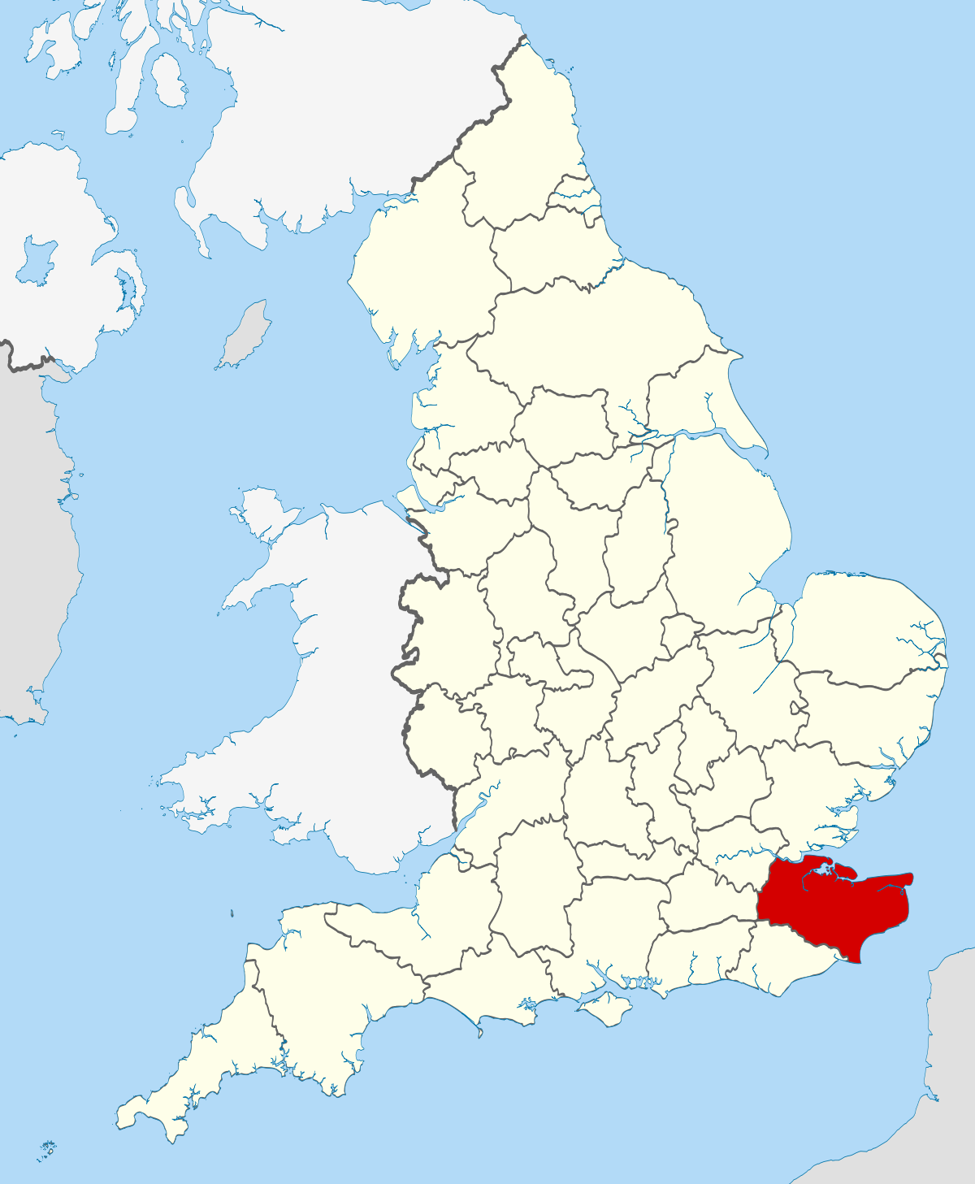
Where am I from?
Notes:
I’m from Kent, which is the red part on the map. Specifically I’m from the most south-eastern part of Kent, 20 miles away from France. On very good days you can see France from my beach.
Whilest in Kent I began my secondary school studys at the Marlowe Academy, Ramsgate School or The Royal Harbour Academy. We went through many names whilest I was there.

Slide 4


“Worst in England”
Notes:
So here’s a few news article titles that sum up my previous school. My school had 3 name-changes whilst I was there and we went through 8 principles. 4% of students in my year achieved more than 4 gcses at C-A* and 11% achieved 1 GCSE.
I failed my GCSEs here, and I dropped out of sixth form after a year. You were only allowed to take 2 A levels at my sixth form, so I chose ICT and Drama. My drama teacher’s work visa had expired so she had to go back to Canada, leaving us without a drama teacher and my ICT teacher had no formal qualifications in ICT. This may sound shocking but not many teachers would want to work at the “worst school in England”, which is why there was such a shortage of teachers. I dropped out of school to go to East Kent College, a local college.

Slide 5
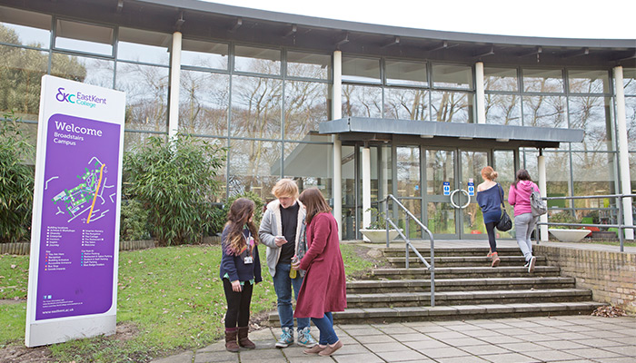
East Kent College
Notes:
I studied a level 3 BTEC in IT at East Kent College. I was meant to study a level 2 because I didn’t have GCSEs or A levels but the head of IT was lazy and decided he couldn’t be bothered to move me down to level 2, so I stayed on at level 3.
I barely passed my first year, coming from a school where you had no homework and worked around an hour a day due to a shortage of staff it was a shock to me. I didn’t feel like working so hard.
In the second year I decided something had to change. I wanted a successful, fulfilled life so I decided to give it my all.
My lowest grade that year was a distinction, I had the highest grades in the class. When I applied to universities I applied to Greenwich, Kent and Christchurch. Unfortunately that lazy head of IT decided to put me on a regular diploma instead of the extended diploma despite me doing all the same work and units as people on the extended diploma and getting the highest possible grade, it wasn’t enough and I couldn’t go to university…

Slide 6
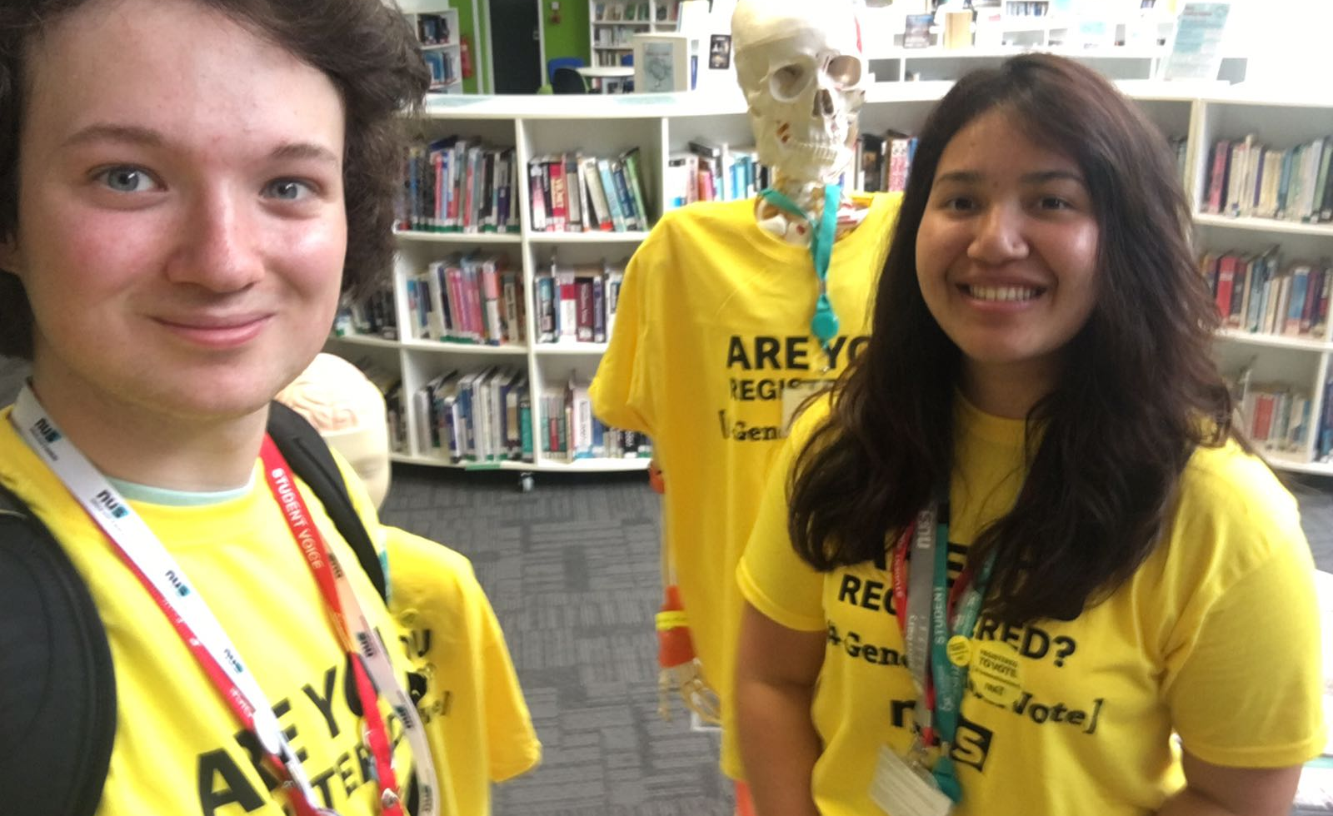
East Kent College
Notes:
I stayed on at East Kent College to do a level 4 Higher National Certificate in Computing and Systems Development. Whilst at College I was elected to become the Student Union’s Higher Education Vice President alongside 9 other people. However, those 9 people all dropped out leaving me to run the students union and everything else that a team of 10 people were supposed to run!!
Throughout my life in the students union I ran events to promote people to vote, as seen in the picture above, I represented my college at national conferences and made sure every single student was happy.
Alongside this I also ran Free Code Camp Kent, a coding club based in the Kent area with around 200 members.
I was also taking my English and Maths GCSE classe at night because my day was so packed I couldn’t possibly fit it in!
At the end of the year I graduated East Kent College with a distinction in my level 4 (highest possible grade), 2 B’s in English and Maths, 4 Microsoft Certified Assiocate certificates in Networking, Security, Programming and Object Orientated Programming. In the end of year survey the satisfaction rating for the students union went from 30% to 85%!
I applied to Bath, Glasgow, Liverpool, Sheffield and Southampton and got offers from all 5 universities!
On a side note: All the universities I applied to in the previous year were around 100 in the league table, so not very good. This year all the universities I applied to were in the top 25 in the UK!

Slide 7
Use these icons for use throughout the document but delete this slide in your final saved presentation

